Slide 1

SMALL OFFICE NETWORK
Cisco Packet Tracer Project
By Thabiso Matlala
R

Slide 2
PROJECT OBJECTIVES
The objective of this project was to design and configure a small office network connecting two different departments using Cisco Packet Tracer.
The network was designed to allow communication between the Sales and Administration departments through a Cisco router using static IPv4 addressing.
This project demonstrates basic enterprise network design, IP addressing, router configuration, switch connectivity, and end-to-end communication.

Slide 3
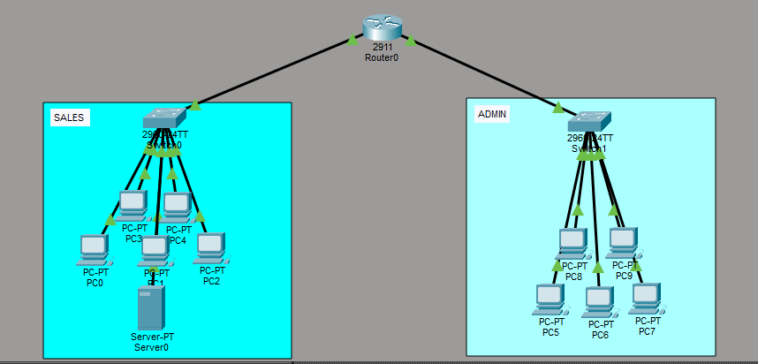
NETWORK TOPOLOGY
The network consists of two separate Local Area Networks (LANs):Sales Department
Network: 192.168.10.0/24Connected to Sales-SW1
Administration Department
Network: 192.168.20.0/24Connected to Admin-SW2
Both switches connect to the HQ Router, which performs routing between the two networks.

Slide 4
DEVICES USED
Devices Used
1 × Cisco 2911 Router
2 × Cisco Catalyst 2960 Switches
10 × Desktop PCs
1 × Server
Copper Straight-Through Ethernet Cables
Cisco Packet Tracer

Slide 5
IP ADDRESSING SCHEME
SLIDE 5 – IP ADDRESSING SCHEME
Sales Department
Network Address: 192.168.10.0/24
Default Gateway: 192.168.10.1
Subnet Mask: 255.255.255.0
Server Address: 192.168.10.100
PC Address Range: 192.168.10.10 – 192.168.10.14
Administration Department
Network Address: 192.168.20.0/24
Default Gateway: 192.168.20.1
Subnet Mask: 255.255.255.0
PC Address Range:
192.168.20.10 – 192.168.20.14
All devices were configured using static IP addresses.

Slide 6
ROUTER CONFIGURATION
Router Configuration Verification
The HQ Router was configured with two active Gigabit Ethernet interfaces.GigabitEthernet0/0IP
Address: 192.168.10.1 Status: Up GigabitEthernet0/1IP Address: 192.168.20.1 Status: Up
These interfaces act as the default gateways for both LANs.

Slide 7
CONNECTIVITY TEST
Connectivity Verification
Several ping tests were performed to verify network communication.
Tests included:
PC to Default Gateway
PC to Server
Sales Department to Administration Department
Administration Department to Sales Department
All connectivity tests were successful, confirming that routing between both networks was working correctly.

Slide 8
SKILLS DEMONSTRATED
Router Configuration✔️
Switch Configuration✔️
Static IPv4 Addressing✔️
Default Gateway Configuration✔️
Network Planning✔️
Basic Troubleshooting✔️
End-to-End Connectivity Testing✔️
Cisco IOS Command Line (CLI) ✔️

Slide 9
REFLECTION
This project helped me understand how routers connect multiple networks and how switches provide connectivity within a Local Area Network. I learned how to configure static IP addresses, verify connectivity using ping commands, and troubleshoot common networking problems. The project also improved my confidence in using Cisco IOS commands and designing basic enterprise networks.

Slide 10
CHALLENGES ENCOUNTERED & LESSONS LEARNED
During the project I experienced several networking challenges, including incorrect cabling, VLAN configuration mistakes, and troubleshooting connectivity issues. By systematically checking router interfaces, switch ports, IP addressing, and cable connections, I was able to identify and resolve these issues. This experience reinforced the importance of patience, verification, and structured troubleshooting in network administration.

